Slide 1
html tags
MCNDHS
Ms. Eng

Slide 2
aim: How do we write links in html?
Do now:
Daily Grade:
On-time/attendance/not leaving the classroom: 25%
Cellphones: 25%
Notes:25%
Classwork/Homework: 25%

Slide 3
what is a link
A connection that links the user to one of the following:
A webpage outside of your repository (Another webpage that’s not yours)
A webpage within your repository
A part of a webpage (ex: back to top)
To another application (pop-ups)

Slide 4
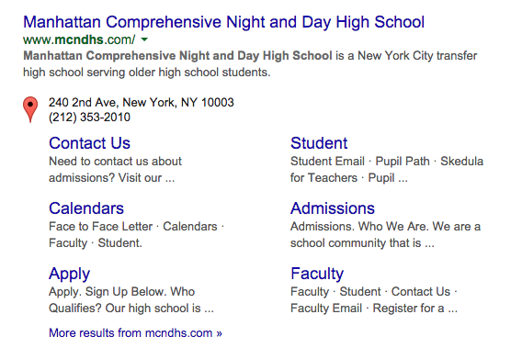
to another webpage

Slide 5
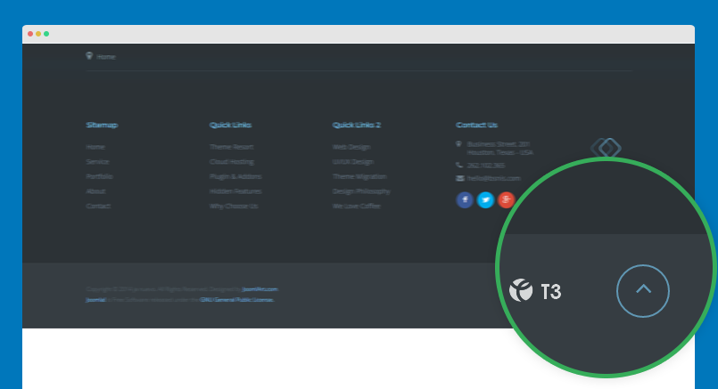
to another section

Slide 6
example: linking to another website
Opening tag:
<a href=“ insert your link here”> write a title for your link
Closing tag:
</a>

Slide 7


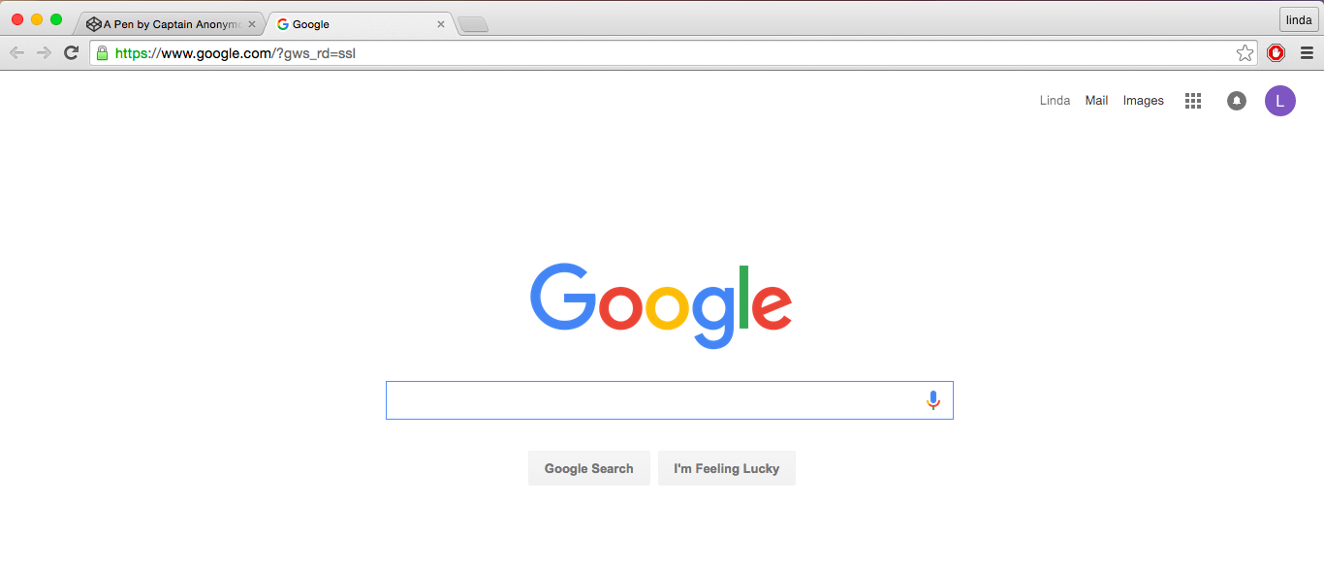
step-by-step

Slide 8


good practice
When you are linking a website, you should write the description of where you will be taking your user instead of just writing “click here”

Slide 9
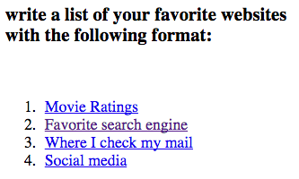
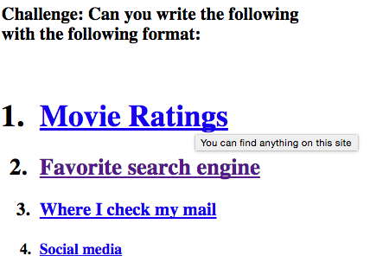
activity

